Slide 1
Final Coursera Capstone Assignment

Slide 2
Business Problem
To expand a pizza restaurant business to 5 new areas in London, UK. I want to recommend to management the best 10 postcode areas to explore based on the following criteria

Slide 3
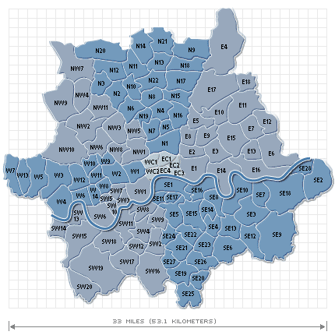
London has over 1700 postal disctricts…a summary map is shown here

Slide 4
The best postcodes are as follows:
Postcode | Other Competitor | Pizza Competitor | Net Score
E17JF | 24 | 1 | 23
E17HY | 24 | 1 | 23
EC2M4QB | 24 | 1 | 23
EC2M4PT | 24 | 1 | 23
EC2M7PY | 24 | 1 | 23
E17HP | 24 | 1 | 23
E17JH | 24 | 1 | 23
E17JJ | 24 | 1 | 23
E17LS | 24 | 1 | 23
EC2M3TP | 24 | 1 | 23
Based on competitive activity:

